Slide 1
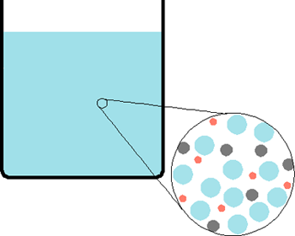
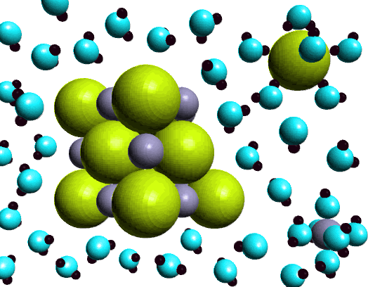
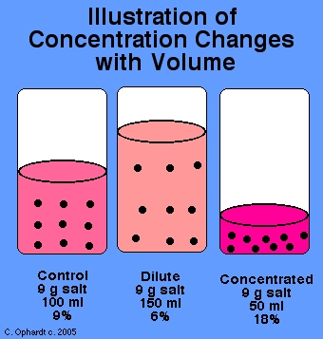
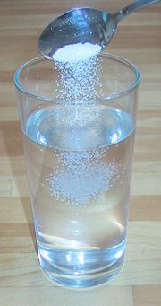
Solutions

Slide 2
15.1 What Are Solutions?
Solution- A homogeneous mixture: a solution has the same composition throughout the mixture.
Solvent- does the dissolving
Solute- the substance that gets dissolved.

Slide 3
Properties of Solutions:
1. homogeneous
2. dissolved particles do not separate out
3. clear and transparent (they may be colored)
4. solutions can not be separated by ordinary filtration

Slide 4
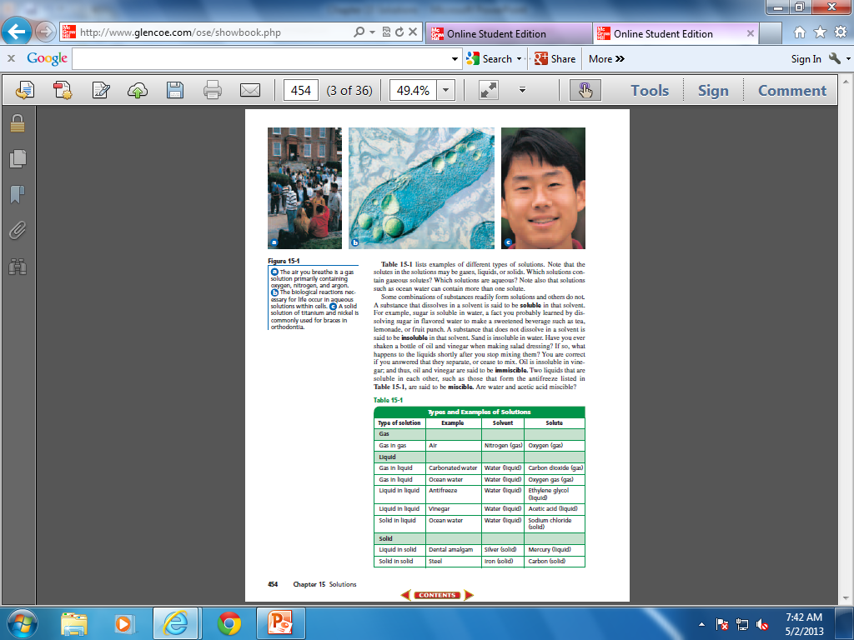
Types of Solutions
1. Gas solution ex air
2. Liquid solution Ex salt water, CO₂ in water, alcohol in water,
3. Solid solution Ex Brass (Cu and Zn), bronze (Cu & Sn), Sterling silver (Ag & Cu)
Solid solutions are called alloys.

Slide 6
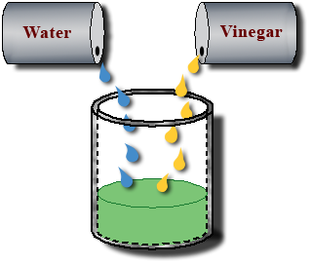
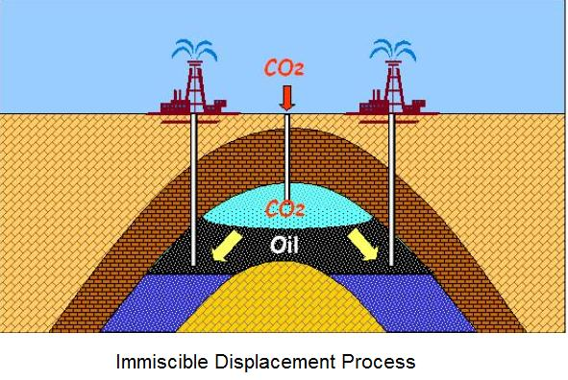
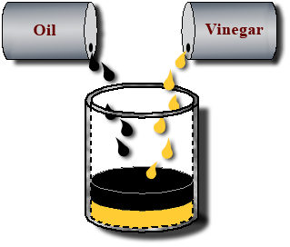
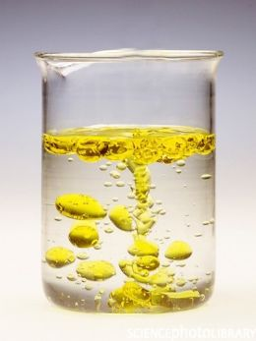
Miscible- liquids that dissolve each other
Immiscible- liquids that do not dissolve each other

Slide 7
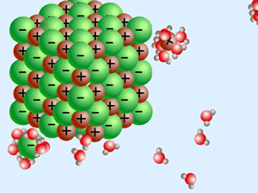
Soluble- a substance that can be dissolved in a given solvent
Insoluble- describes a substance that cannot be dissolved

Slide 8
Solubility- refers to the maximum amount of solute that will dissolve in a given amount of solvent at a specific temperature and pressure.
Saturated solution- contains the maximum amount of dissolved solute for a given amount of solvent at a specific temperature.
Unsaturated solution- contains less dissolved solute for a given temperature and pressure than a saturated solution
Supersaturated solution- contains more dissolved solute than a saturated solution at the same temperature.

Slide 9
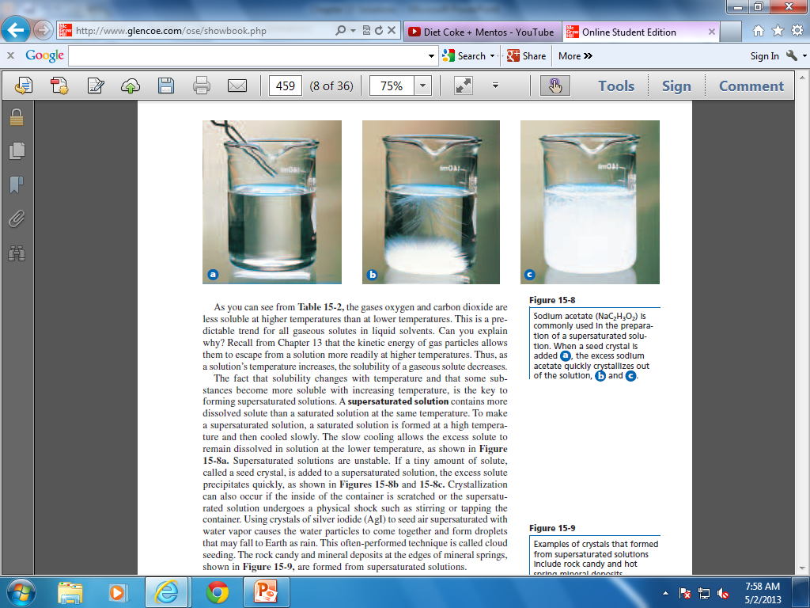
Supersaturated Solution- contains more dissolved solute than a saturated solution at the same temperature.

Slide 10
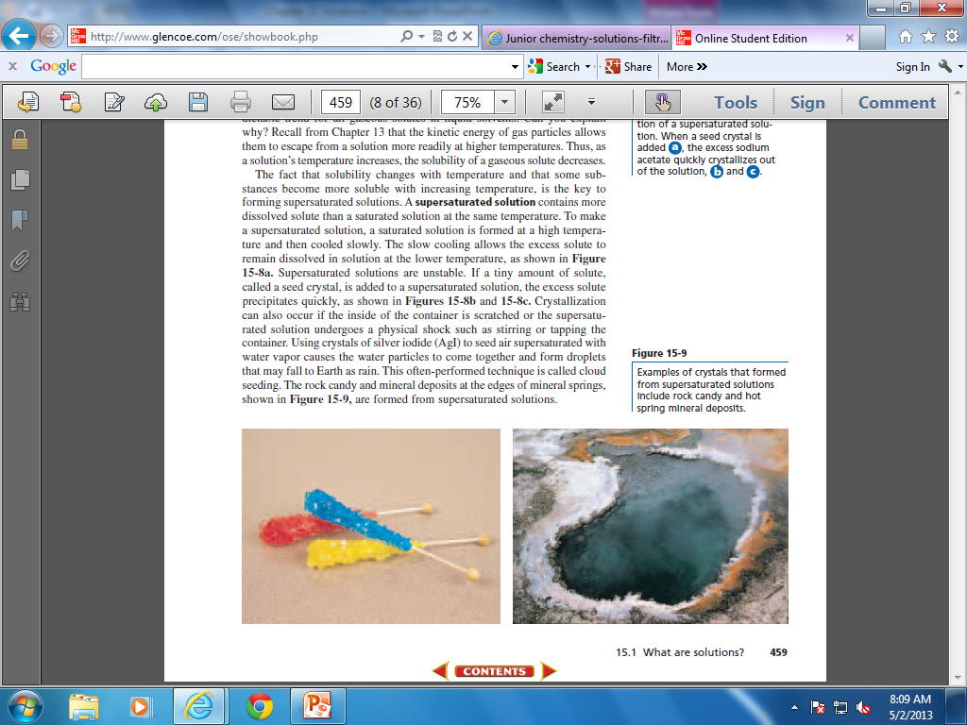

Slide 11
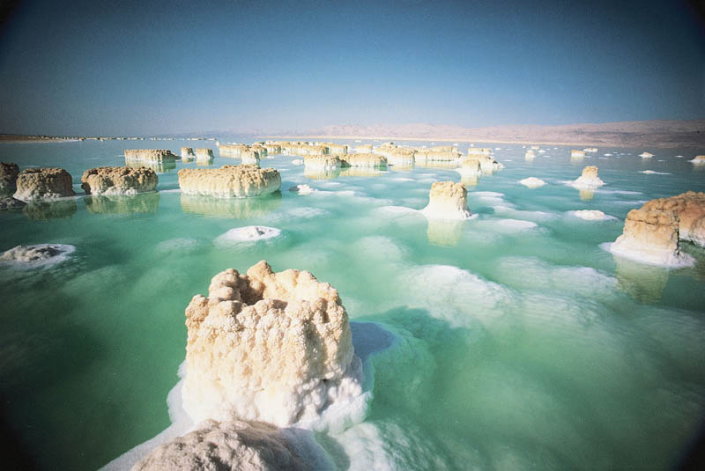


Slide 12
Factors That Affect Solubility
Nature of the Solvent- Ionic compounds and polar molecules dissolve best in polar solvents. Non-polar solutes dissolve best in nonpolar solvents. (like dissolves like)
Temperature- for solid and liquid solutes, increasing the temperature increases the amount of solute that will dissolve.
3. Pressure- Pressure has little effect on the solubility of solid or liquid solutes. For gases, increasing the pressure increases the amount of gas that can be dissolved. (ex soda).
http://www.youtube.com/watch?v=LjbJELjLgZg
http://www.youtube.com/watch?v=hKoB0MHVBvM

Slide 13
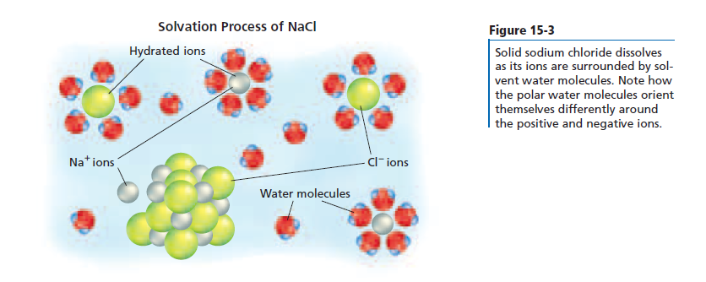
Solvation*

Slide 14
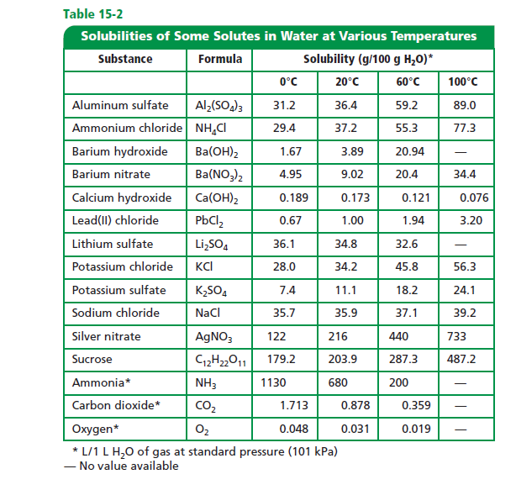
Solubility

Slide 15
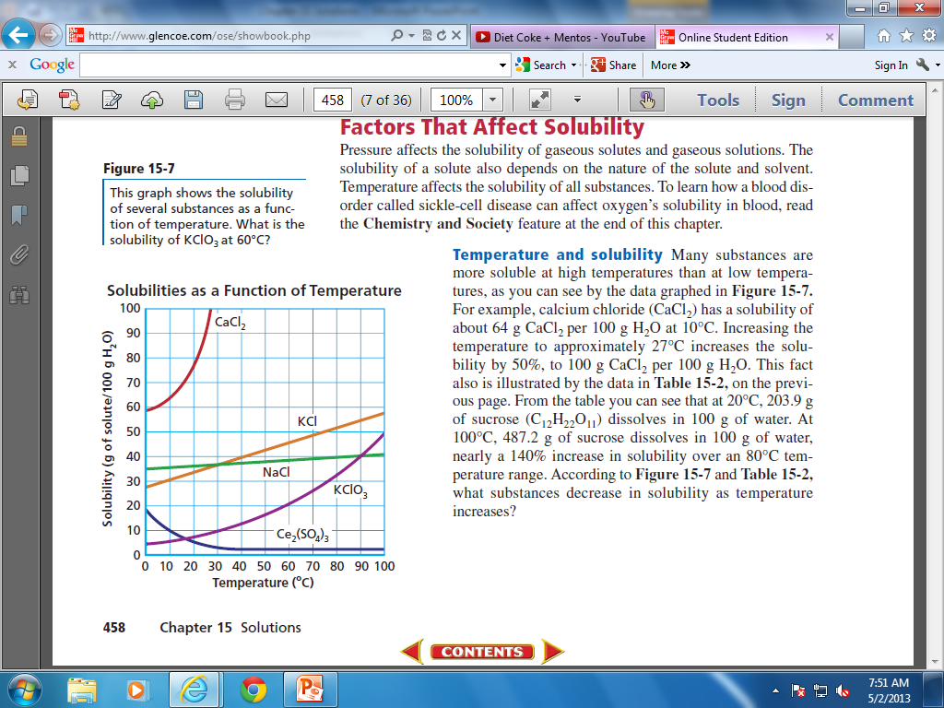
Solubility Curve
21 g of solute
(KClO₃)/ 100g H₂O

Slide 16
Solubility Curve

Slide 17
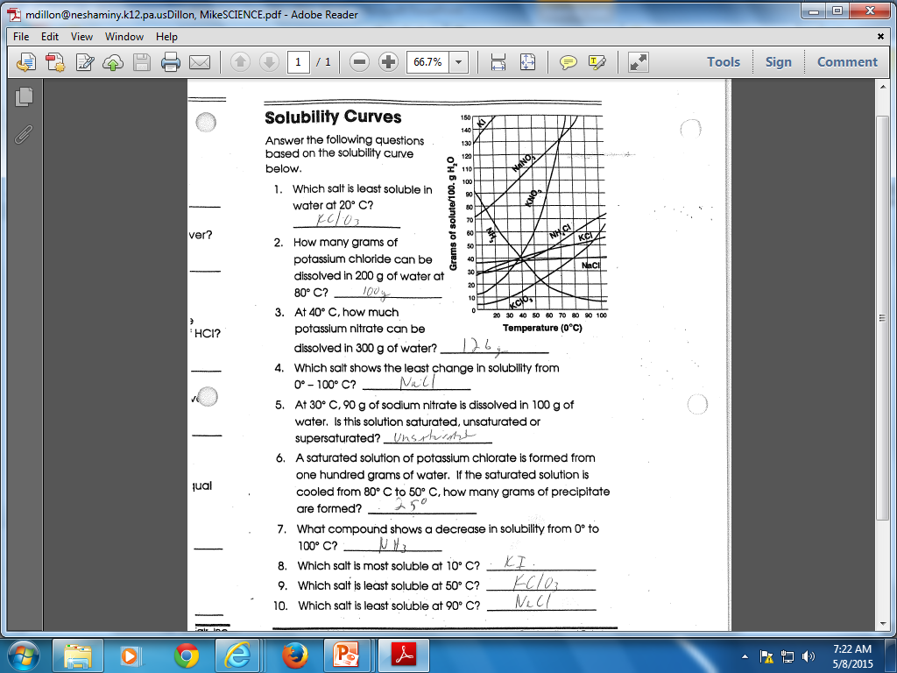

Slide 18
Factors that Affect the Speed of Dissolving
The most usual factors that affect the speed at which something dissolves are the temperature of the solvent, and any stirring of the solution that is being done. The relative quantity of solvent compared to solute is also an important factor, since there is only so much solute that will dissolve before the solution is saturated. Also surface area.

Slide 19
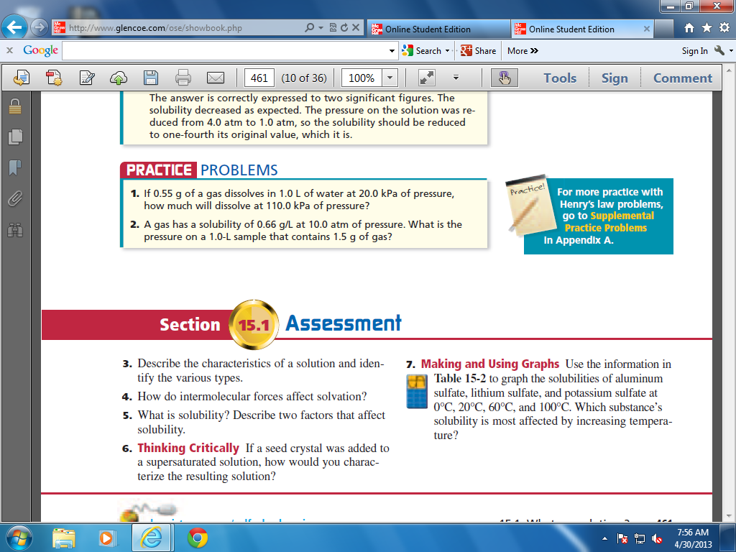
3. All solutions are homogeneous mixtures containing two or more substances. Solutions may be liquid, solid or gas.
4. The attractive forces between solute and solvent particles overcome the forces holding the solute particles together, thus pulling the solute particles apart.
5. Solubility refers to the maximum amount of solute that can dissolve in a given amount of solvent at a particular temperature and pressure. Surface area, temperature and pressure affect solubility.
6. After the excess solute particles crystallize out of solution, the solution is saturated.
7. Aluminum sulfate shows the greatest change in solubility over the temperature range.

Slide 20
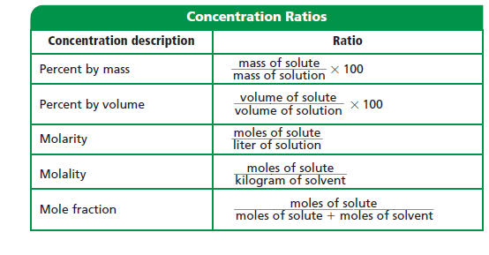
15.2 Solution Concentration
Expressing concentration

Slide 21
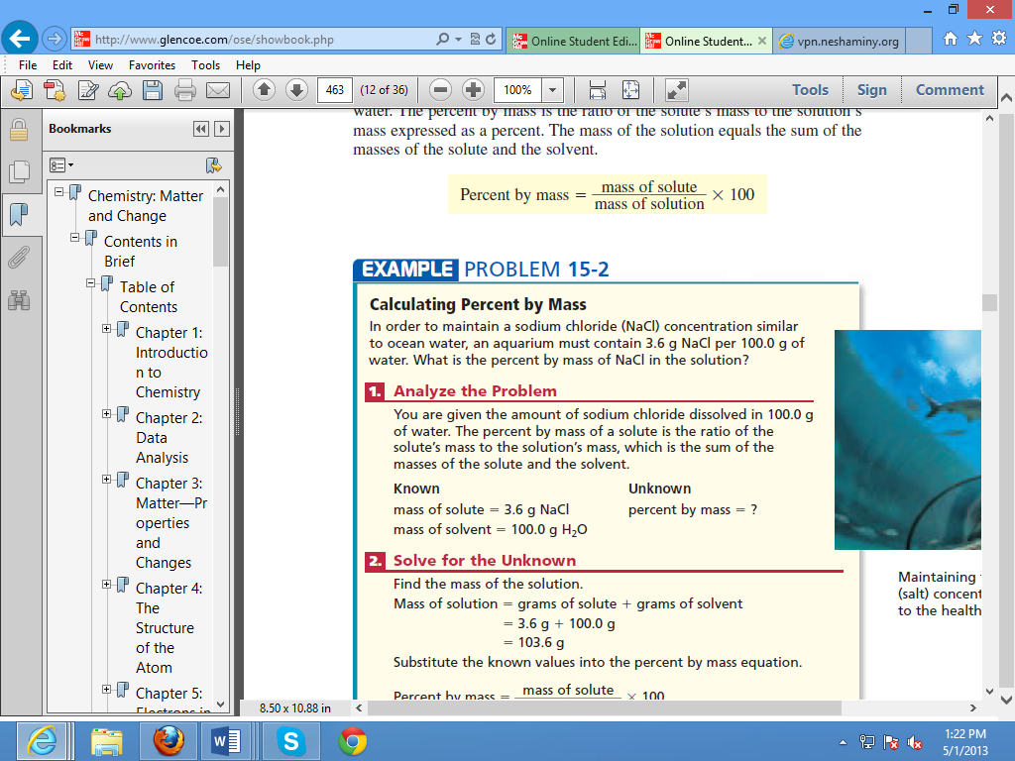
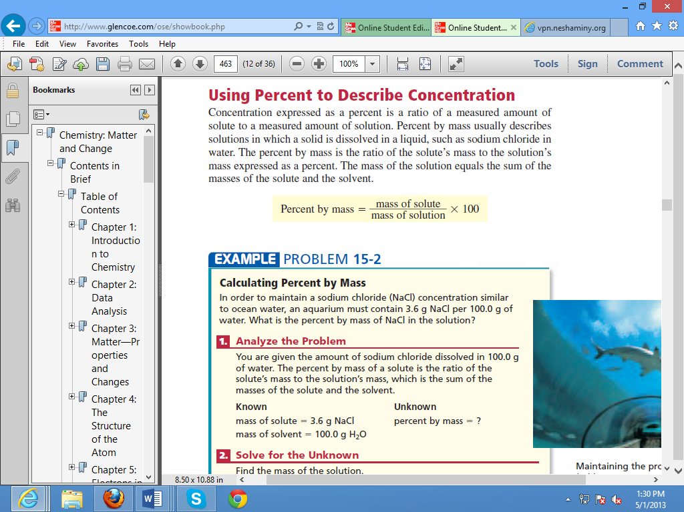
Answer: 3.5%

Slide 22
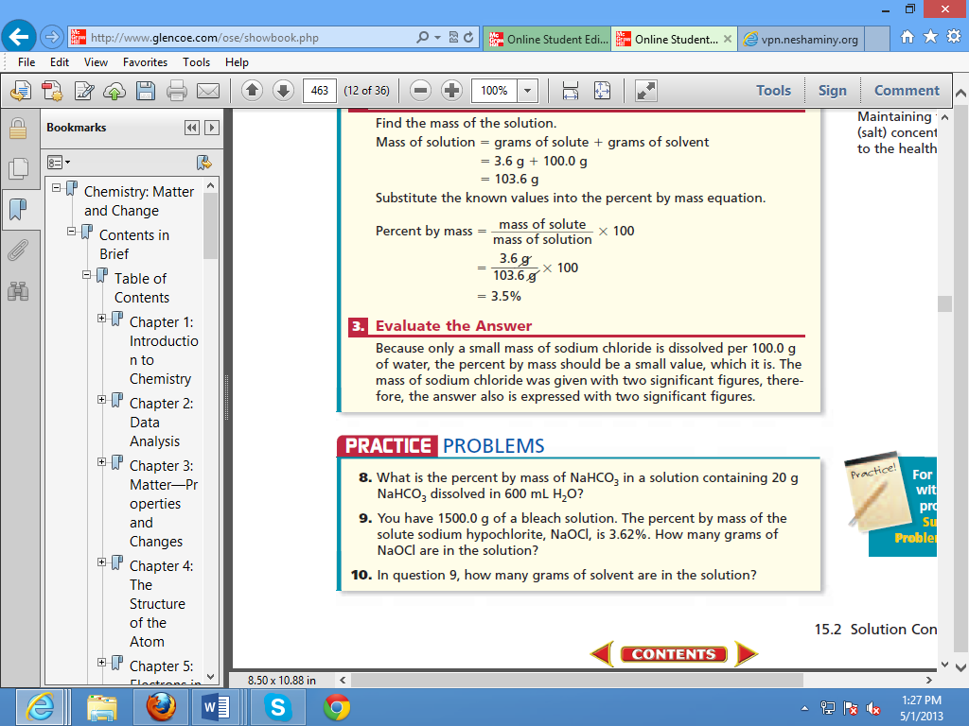
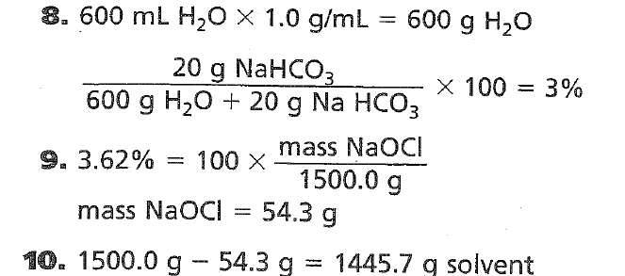

Slide 23
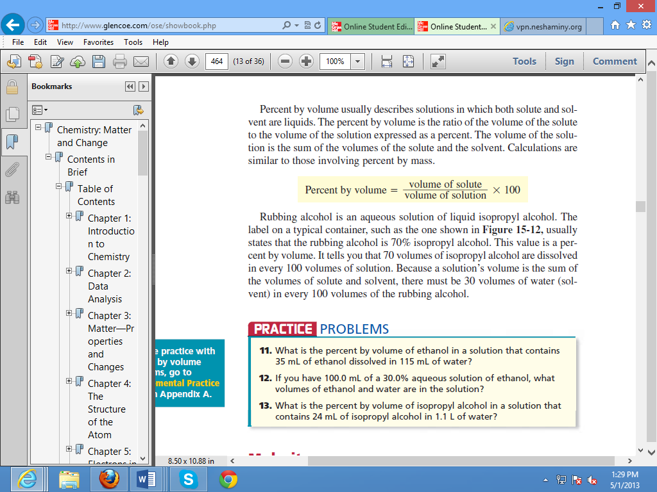
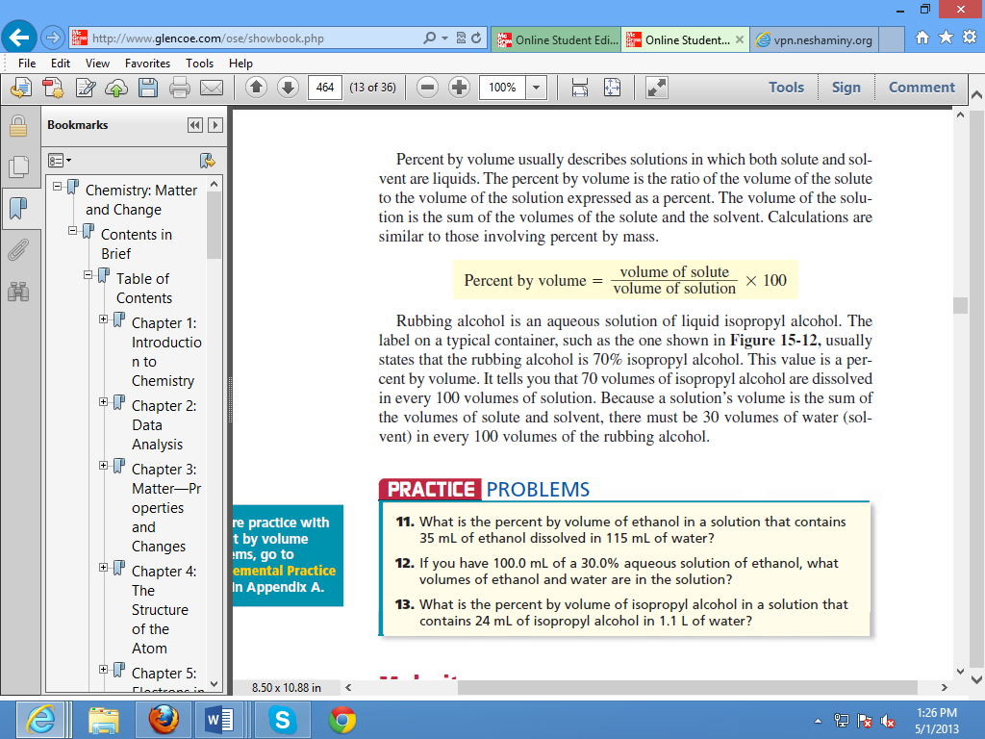

Slide 24
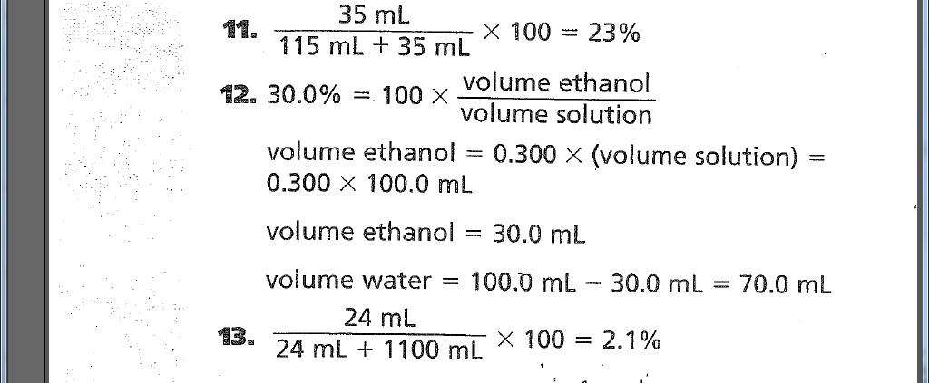

Slide 25
Molarity
Molarity (M) – is the number of moles of solute dissolved per liter of solution. Molarity is known as the molar concentration. The unit M is read as a molar. A liter of solution that contains one mole of solute is a 1M solution, which is read as a one molar solution. A liter of solution containing 0.1 mole of solute is a 0.1M solution.

Slide 26
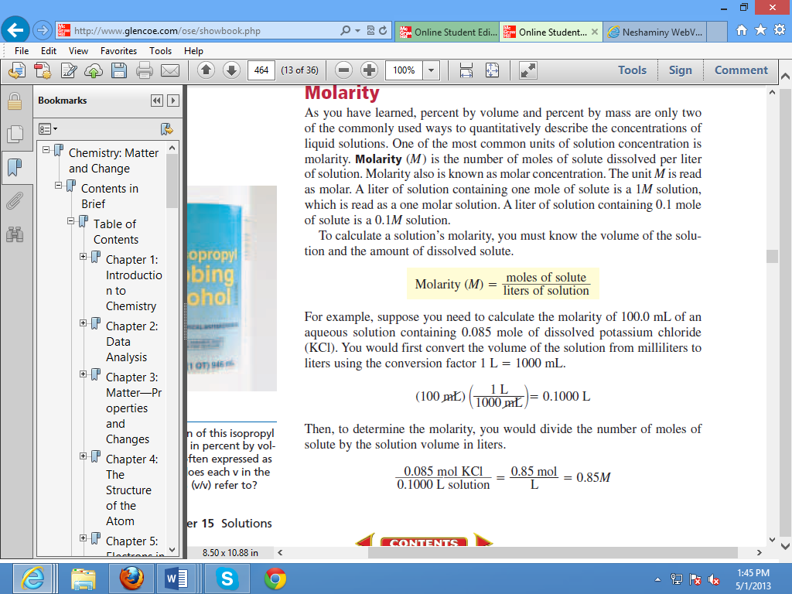
Ex. Calculate the molarity of 100.0 ml of an aqueous solution containing 0.085 mole of dissolved potassium chloride (KCl).
Don’t forget to convert mL to liters!!

Slide 27
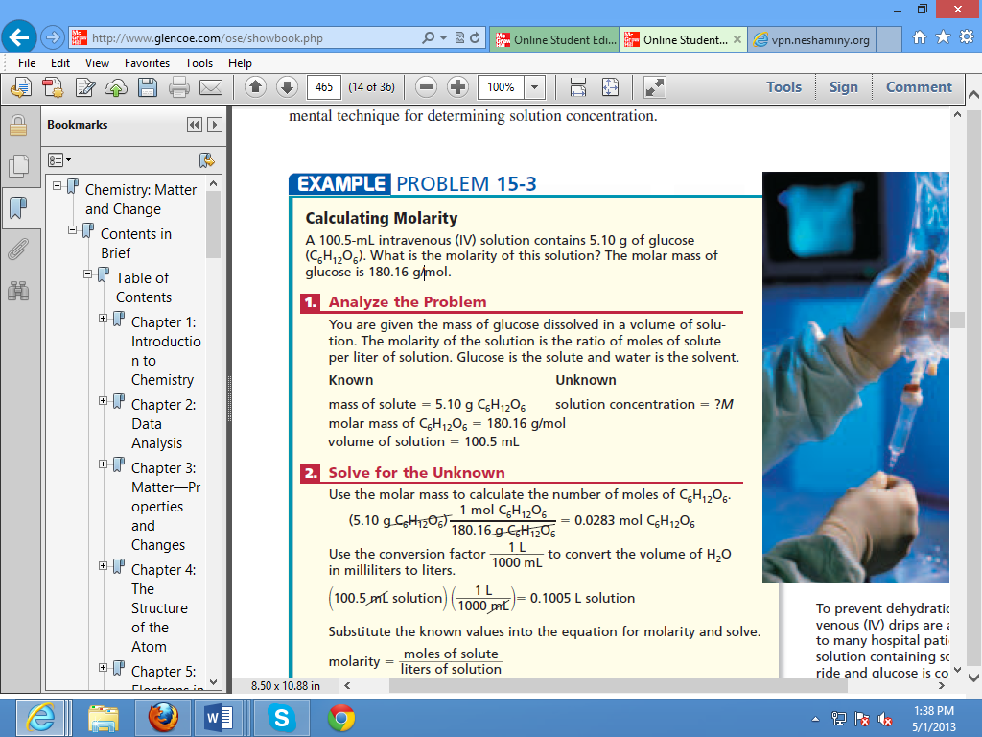
Answer: 0.282M- (This example is in textbook Pg465)
Before solving:
You must convert mL to Liters
You must convert grams to moles

Slide 28
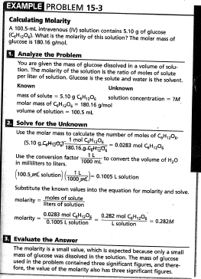

Slide 29
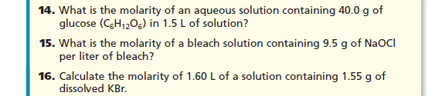
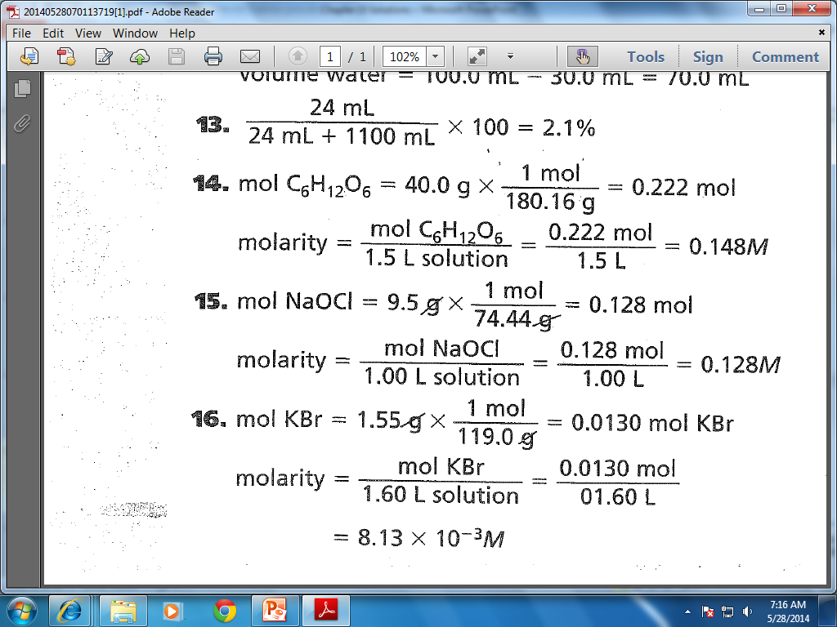

Slide 31
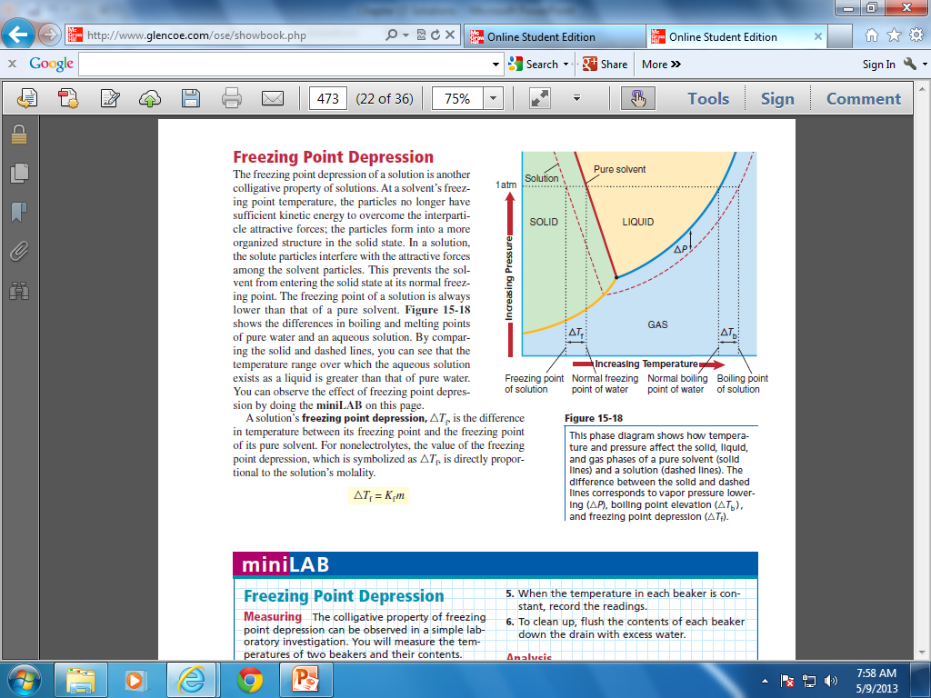
15.3 Colligative Properties of Solutions
Colligative Properties- Properties of solutions that are affected by the number of particles but not the identity of dissolved solute particles.
Electrolytes
Vapor Pressure Lowering*
Boiling Point Elevation
Freezing Point Depression

Slide 32
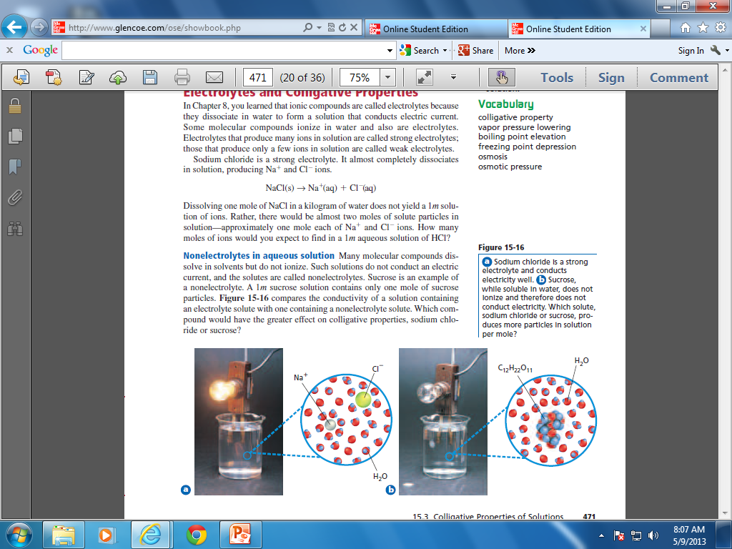
15.3 Colligative Properties of Solutions
Electrolytes- ionic compounds are called electrolytes because they dissolve in water to form a solution that conducts electric current.
http://www.youtube.com/watch?v=1XWnovm6JLs

Slide 33
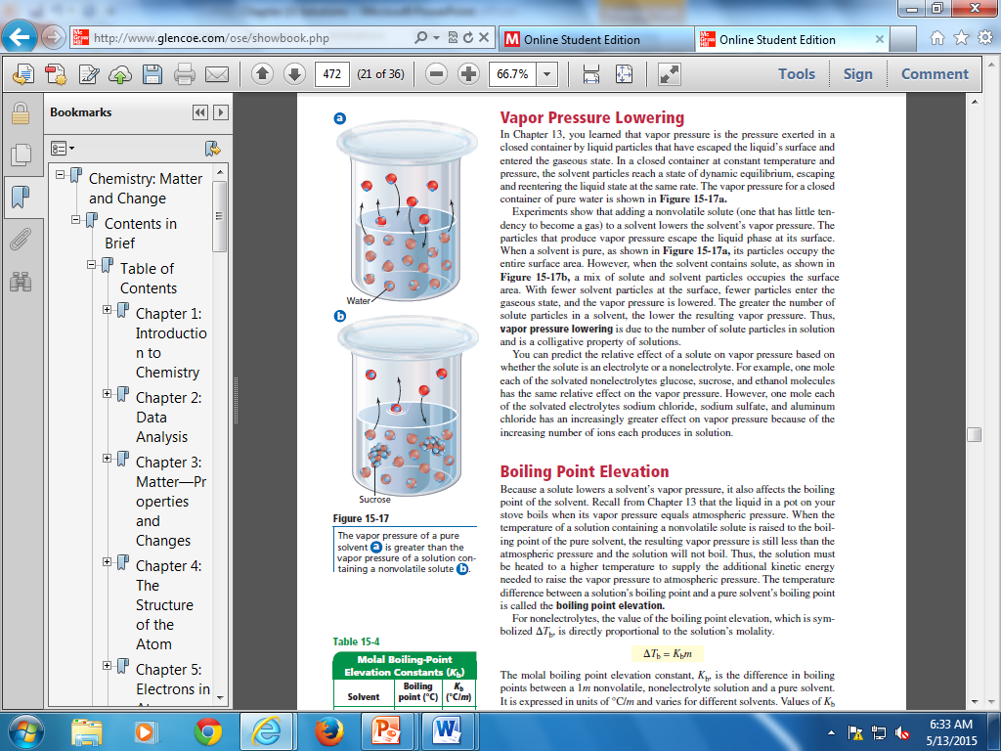
Vapor Pressure Lowering*
Adding a solute to a solvent can cause the Vapor Pressure to lower.

Slide 34
15.3 Colligative Properties of Solutions
Boiling Point Elevation
Freezing Point Depression
http://www.youtube.com/watch?v=7SM16Z87es8

Slide 35
Osmosis and Osmotic Pressure
Osmosis
Osmotic pressure

Slide 36
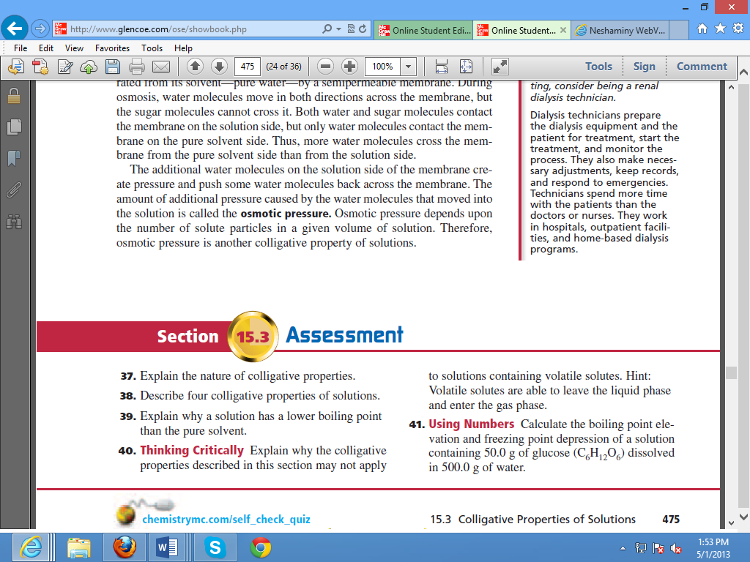

Slide 37
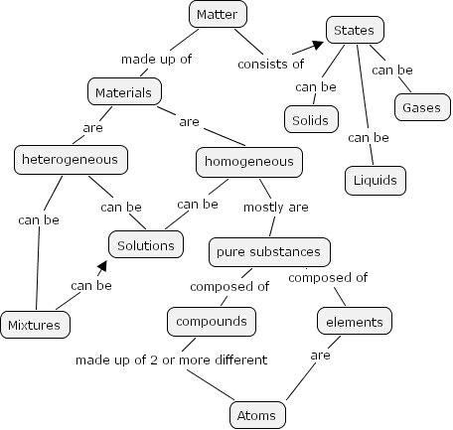

Slide 38
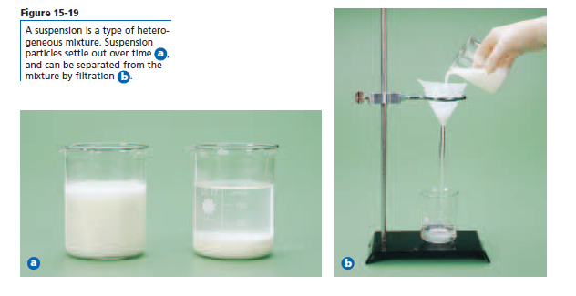
15.5 Heterogeneous Mixtures (Non-solution Mixtures)
Suspensions – A mixture that separates if allowed to settle e.g. oil and vinegar.

Slide 39
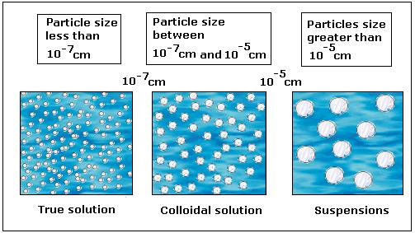
15.5 Heterogeneous Mixtures (Non-solution Mixtures)
Colloid- a stable heterogeneous mixture. Colloids do not separate. Usually appear cloudy or milky. Ex. Milk, mayonnaise, jelly, jells and foam.

Slide 40
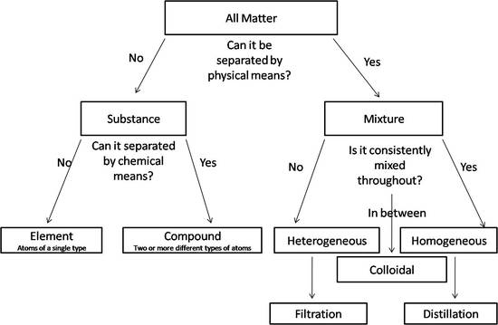

Slide 41
Molarity (M) = Number of moles of solute
Solution volume (liters)

Slide 42
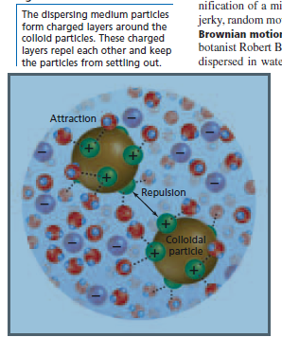
15.5 Heterogeneous Mixtures (Non-solution Mixtures)
*Brownian Motion- the erratic motion of colloid particles.
https://www.youtube.com/watch?v=4m5JnJBq2AU

Slide 43
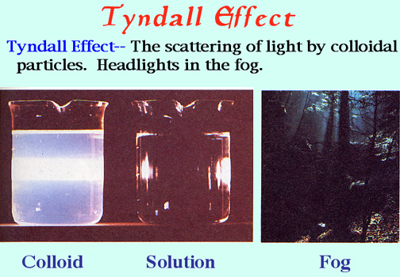
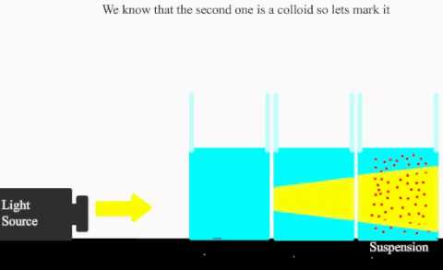
15.5 Heterogeneous Mixtures (Non-solution Mixtures)
*The Tyndall effect-

Slide 44
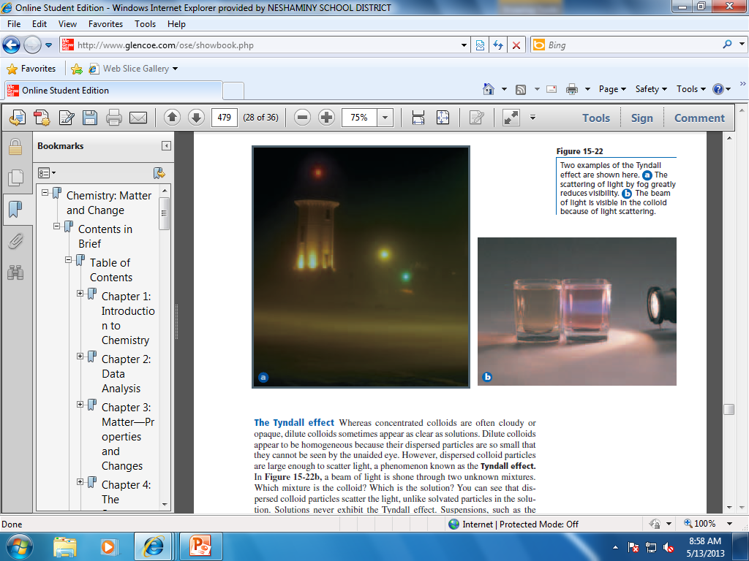
https://www.youtube.com/watch?v=V7eqD-Jw6m4
http://www.youtube.com/watch?v=E2ULbn7Uxsk
http://www.youtube.com/watch?v=oZPiyEZgc2s

